Slide 1
Creutzfeldt-Jakob’s disease or Prion Disease
or Mad Cow disease
It belongs to a group of neurodegenerative diseases called Transmissible Spongiform Encephalopathies (TSE).
The infectious agents responsible for TSE are Prions, PrP^{c} converted into PrP^{sc}. They are generally hard to eliminate, and are extremely resistant to:
Heat
Radiation
Disinfection
Protein digestion (degradation)

Slide 2
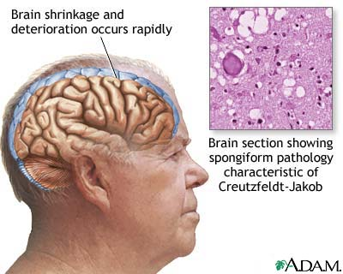
Creutzfeldt-Jakob’s Disease
(Mad cow disease or Prion disease)

Slide 3
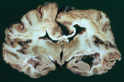
Severe Brain Atrophy in CDJ’s patient
www.scienceclarified.com

Slide 4
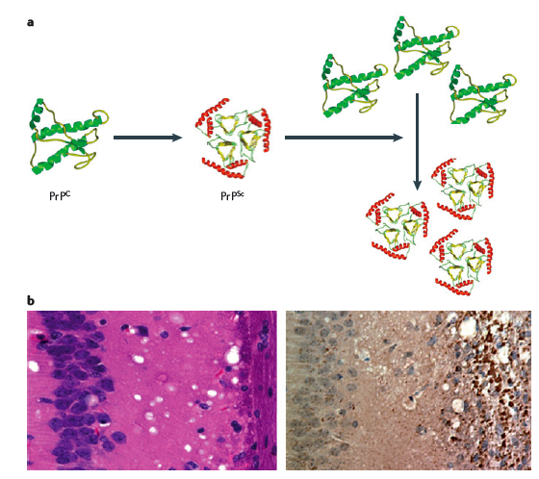
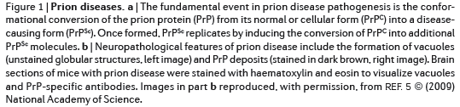
Models for conformational conversion of PrP^{c} into PrP^{sc}
vacuoles
PrPdeposits

Slide 5
Symptoms in Creutzfeldt-Jakob’s Disease
-It could take years (decades) before a carrier of prion disease will become fully symptomatic.
-Symptoms are characterized by cognitive decline, which may be fulminant and progress to akinetic mutism within few weeks.
-Cerebellar signs are evident (balance and coordination dysfunction -ataxia, changes in gait, rigid posture, and seizures).
mood swings
depression
anxiety
memory lapses
social withdrawal
clumsiness or lack of coordination
insomnia

Slide 6
Epidemiology of Creutzfeldt-Jakob’s disease (CJD)
CJD is, among the Transmissible Spongiform Encephalopathies, the most diffuse one.
CJD can be classified as
Sporadic sCJD: etiology not known, caused by both exogenous and endogenous factors, represents 85% of all the cases of CJD. In the United States, there are approximately 200 sporadic CJD cases per year.
Familial fCJD: caused by mutations in the gene for PrP (prion protein). 15% of CJD cases are inherited.
Iatrogenic iCJD: caused by the spreading of the infectious agent due to contaminated surgical tools, to the transplantation of tissues, or to the administration of pituitary hormones from deceased patients affected by the disease. 1% of CJD cases.
Variant vCJD: caused by the transmission of Bovine Spongiform Encephalopathy (BSE) prion to humans (aka Mad Cow disease).

Slide 7
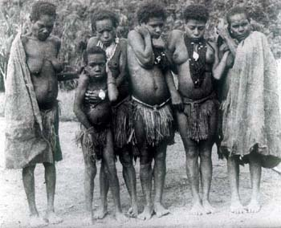
KURU: laughing death -Papua New Guinea (1957)
http://www.biologie.uni-duesseldorf.de
KURU and prion’s disease: similarities in the symptoms and in cerebellar ataxia

Slide 8
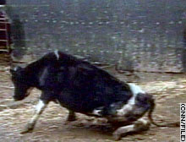
Cow affected by Bovine Spongiform Encephalitis
www.jonbarron.org
http://www.youtube.com/watch?v=VgB9sg5dy8w

Slide 9
As the disease rapidly progresses, patients with all forms of CJD generally experience:
* visual deterioration and eventual blindness
* dementia
* involuntary muscle contractions
* muscle paralysis
* slurred speech
* difficulty swallowing
* incontinence
* coma

Slide 10
Diagnosis:
-Electroencephalography
-MRI
“Probable” CJD is based on the clinical symptoms.
-Post-mortem immunohistochemistry of PrP^{sc} aggregates.
-Biopsy of the tonsils and, in 30% of the cases, of skeletal muscles can confirm CDJ. Determination of protease-K resistant form PrP^{sc}.

Slide 11
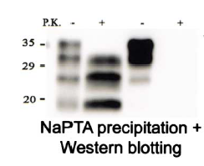
Absence of Protease-K-digested PrP in CJD used for diagnosis
CJD
Control
Prion protein

Slide 12
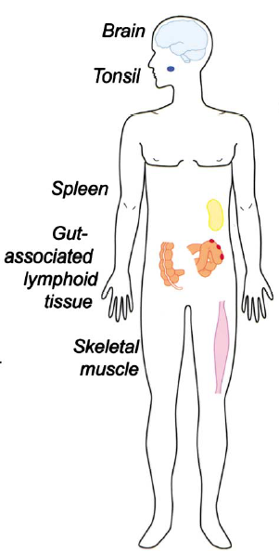
Tissues where PrP^{sc} accumulates
!!! vCJD is of oral origin, and PrP^{sc} could take years before converting PrP^{c} Role of oral mucosas in first accumulating then spreading PrP^{sc}

Slide 13
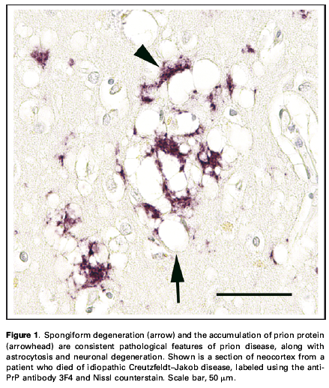
Spongiform (intracellular vacuolation) change in the cortical gray matter of the brain, characteristic of TSEs and prions aggregates
Walker et al.,

Slide 14
Features of TSEs and CJD
*Neuronal death
*Neuronal apoptosis
*Astrogliosis (as a cause or a consequence of inflammation)
*Protein misfolding and aggregation
*Precipitation of aggregates (proteinaceous material) both at an intracellular and extracellular level (amyloid plaques)

Slide 15
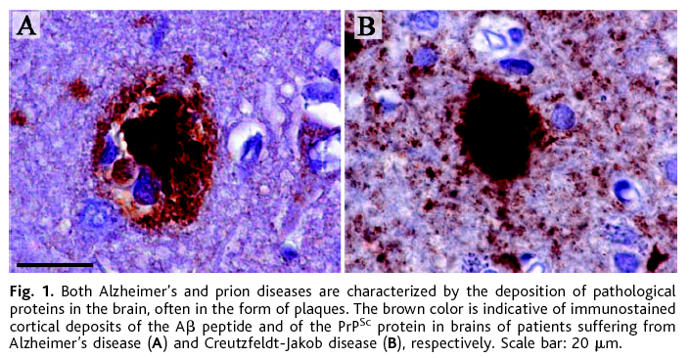
Deposition of fibrillar proteinacious material
in Creutzfeldt-Jakob’s disease (prion disease)
Prion disease: Conformational changes in the prion protein lead to extracellular accumulation of amyloid aggregates, similar to those characteristic of AD, and positive to prion protein staining. Probably, replication and accumulation of the protease insensitive PrP^{sc} results in fibril formation and plaque deposition.
Alzheimer’s
Creutzfeldt-Jakob’s
Aguzzi A, Haass C. Science. 2003 Oct 31;302(5646):814-8. Review.

Slide 16
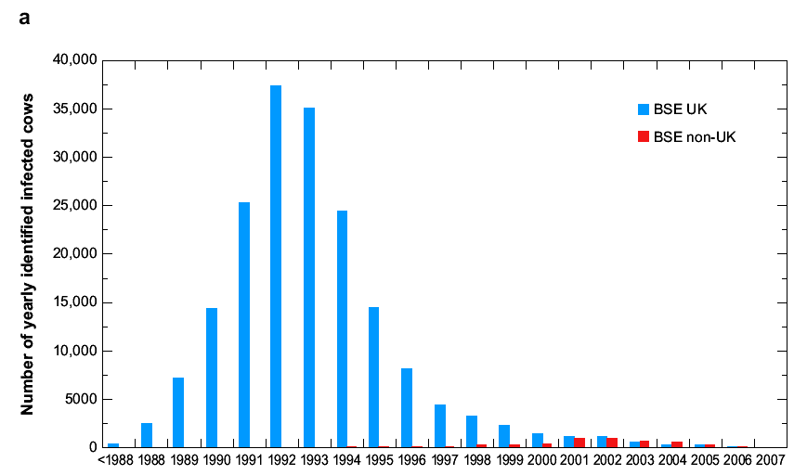
Incidence of BSE reported worldwide

Slide 17
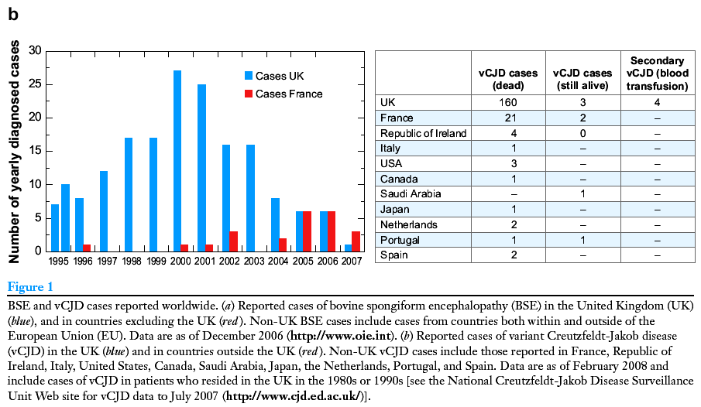
Incidence of vCJD reported worldwide

Slide 18
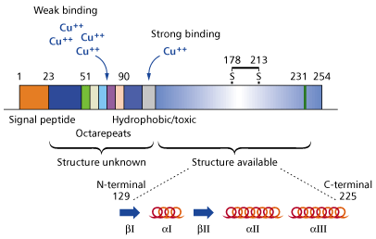
Prion Protein: domains and α-helix structures
www.chemsoc.org
-PrPc contains 208 aminoacid residues and is abundantly expressed in neurons and glial cells
-Signal peptide sequence
-Octarepeats followed by a short Hydrophobic/toxic structure
-The C-terminal portion of the protein is a globular structure that contains 3 α-helix domain and 2 β-helical domains. This domain folds rapidly and is extremely stable

Slide 19
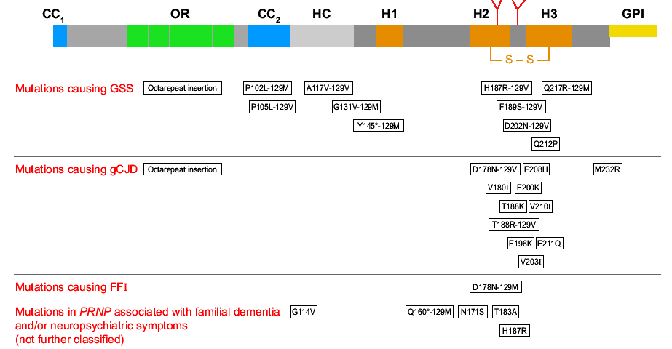
The prion protein: functional domains and mutations causing inherited prion’s diseases

Slide 20
Functional domains of the prion protein
OR: not required for PrPc function, it might influence the change of conformation in PrPsc, as OR KO mice do not propagate the disease. Protects from apoptosis.
CC1: probably involved in protein internalization/trafficking. CC1 KO mice are viable and could develop the disease.
CC2: might work in concert with HC region, as partial deletion of either or the other domain, or ablation of one domain and partial deletion of the other accelerate the pathology in mice.
C-terminal: gene KO on H2, H3 or both domains leads to ataxia and neuron disease, BUT FAIL TO REPLICATE PRIONS.
No transmission of disease from H2 KO and H3 KO to other animals. H2 and H3 might stabilize the conformation of the protein.
C-terminal deletion prevents GPI anchoring of the protein, no development of the disease.

Slide 21
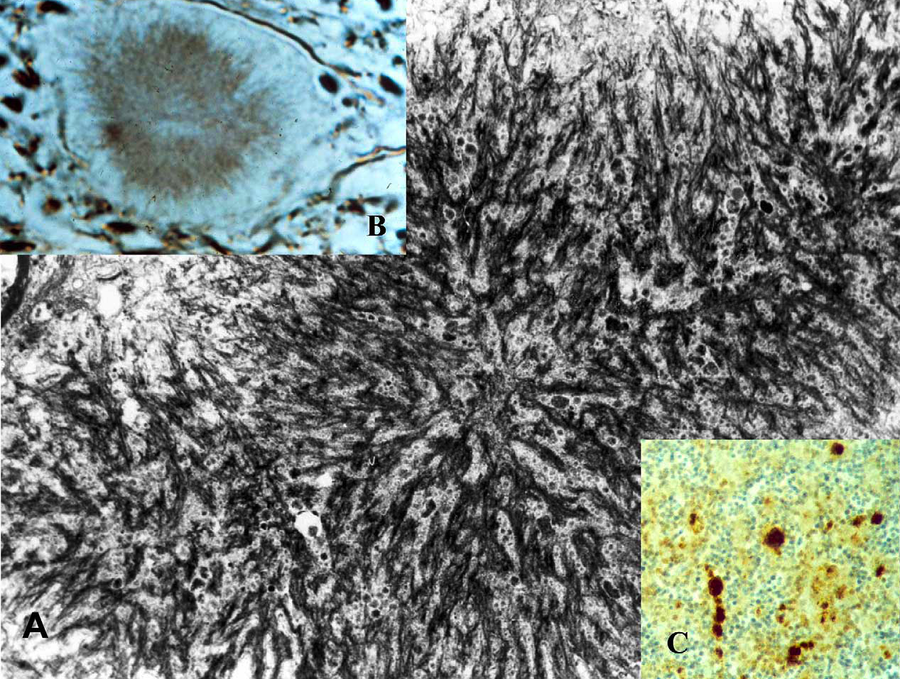
Amyloid plaques in TSE
Kuru disease
GSS disease
Gerstmann-Straussler-Sheinker disease
Kuru disease

Slide 22
http://www.youtube.com/watch?v=10ZIdIRInSc

Slide 23
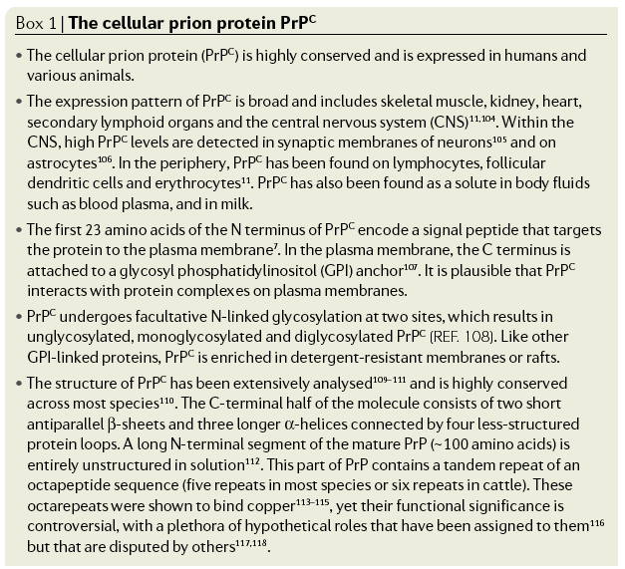
Aguzzi et al., Nat Rev Mol Cell Biol. 2007 Jul;8(7):552-61

Slide 24
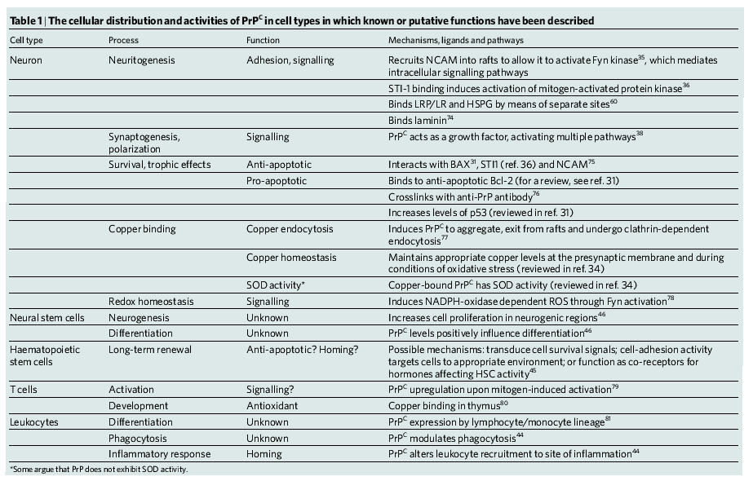
Physiologic role of PrP^{c}
Caughey and Byron, 2006 Nature 443-19

